Slide 1
The Battle of Neighborhoods
Big Neighborhoods V.S. Small Neighborhoods
By Xusheng Yan, Nov 23, 2019

Slide 2
Table of Content
Introduction
Data
Methodology
Empirical Results
Discussion
Conclusion
Drawbacks

Slide 3
Introduction – 1.1 Intro
As one of the largest cities in Canada, Toronto, the capital of the province of Ontario, is the non-negligible place not only for the explorers but also for the investors. Have the largest amount of population in Canada with the population density of no fewer than 400 people per square km, Toronto is the ideal place to run business such as restaurant.
As the neighborhood of Toronto, Montreal, the second largest cities in Canada in terms of population, is also a great option for the investor or business starter. Different from Toronto, which is an English culturally based city, Montreal is a unique and special city in Canada that is built upon the French culture.
After comparing the big two neighborhoods, this project will also analyze the small neighborhoods inside each city. In the case of Metropolitan Toronto, which is also called the Greater Toronto Area (GTA), contains various neighborhoods. Each neighborhood may have different taste of cuisine so that the suggestions or the opportunities for the restaurant investors may also vary from neighborhood to neighborhood. Same pattern may or may not apply to the city of Montreal, which is worth our investigation.

Slide 4
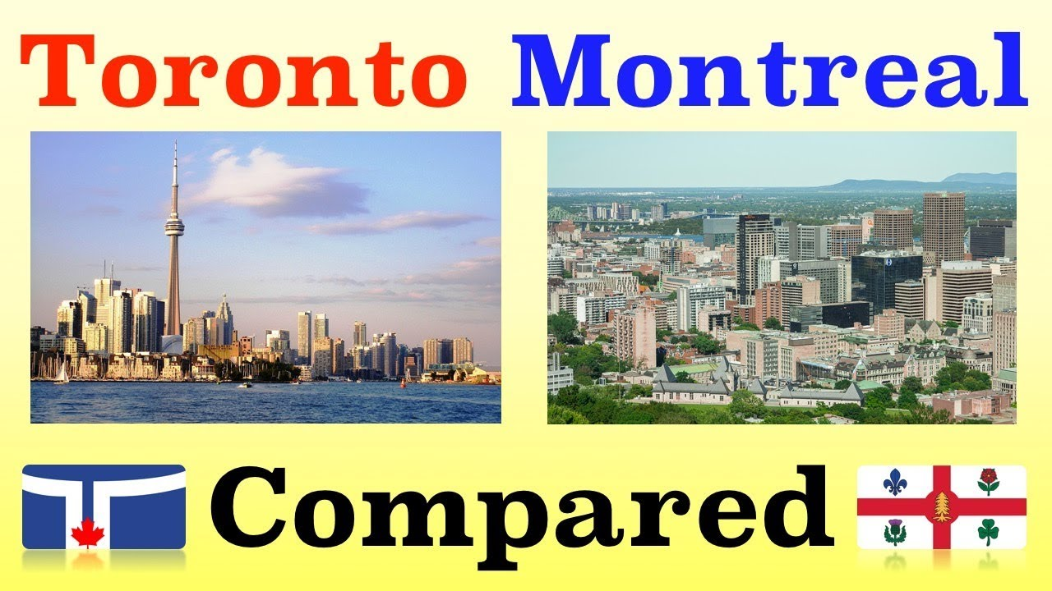
Intro – Cont’d

Slide 5
1.2 Business Problem
1. Does the suggestion vary for different restaurant investors if we investigate the small neighborhoods inside the city?
2. Does the suggestion vary between these two big neighborhoods since their culture is different?
3. What is the most popular cuisine for each small neighborhood?
4. What is the most popular cuisine among these two big neighborhoods?

Slide 6
1.3 Target Audience
The target audience would be the investors or business starters who are looking to open a restaurant located either in Toronto or Montreal. Specifically, the audience would be wondering which city should they start. Or, if they have decided the location of the city but not the explicitly area, they would curious about which is the best neighborhood to start regarding their own cuisine.

Slide 7
Data
The data that we use in this project is from the Foursquare location: https://foursquare.com
We also need the information of coordinates via: https://www.latlong.net
The list of the neighborhoods of Toronto can be found: https://en.wikipedia.org/wiki/List_of_neighbourhoods_in_Toronto
The list of the neighborhoods of Montreal can be found: https://en.wikipedia.org/wiki/List_of_neighbourhoods_in_Montreal

Slide 8
Data – Cont’d
We collect the data via the different queries from Foursquare. In order to be able to provide actionable and meaningful suggestions to the restaurant business runners or investors, we will query the data for Toronto and Montreal along with the small neighborhoods in each city. By searching the data on Foursquare, we can obtain the most up-to-date restaurant information that other customers or users would get. With the first-hand information, we can have the idea regarding which type of cuisine is the most popular choices in each small and big neighborhoods. This analyzation would provide both the detailed view as well as the whole picture in terms of the restaurant business to the target audience. After we collect the data, we implement the data cleansing and extract the useful information that is valuable for our target audience. We will analyze the information and provide the feedback in the discussion section.

Slide 9
Methodology - 3.1 Query the data
As aforementioned, we will query the data from the Foursquare by defining the latitude and longitude that we obtain after we input the different names of different neighborhoods. The name of the neighborhoods we could get the from the lists of the neighborhood of Toronto and Montreal. We could get the restaurant by setting the venues to restaurant and limit the radius we would like to investigate. We can also define the limit of our query.

Slide 10
3.2 Cleansing the data
After we obtain the restaurant data, we will drop any outlier or unnecessary data and summarize the data with the different neighborhood categories. By doing this, we would be able to finalize the data and make it ready for analyzing.

Slide 11
3.3 Analyzing the data
We will analyze the data from the tables that we construct from previous step. We will discuss the tables for both cities as well as the small neighborhoods inside each city.
Besides, we will visualize the data of the restaurants for Toronto and Montreal along with the small neighborhoods. This would help us the communicate with our target audiences and provide feedback and suggestions from data visualization. By combing the information from the map and the table, we are able to conclude the more comprehensive results.

Slide 12
3.1 Query the data – Cont’d
One would question that how we can define the radius for each neighborhood. In this project, we are using the one-size-fit-all and will keep the default threshold as we used during the course. This may or may not yields the overlapping results depending on the numbers of the restaurants we queried with our limitation. However, the basic sense of the restaurants would not be affected by this setting and we could facilitate the querying process with this method.

Slide 13
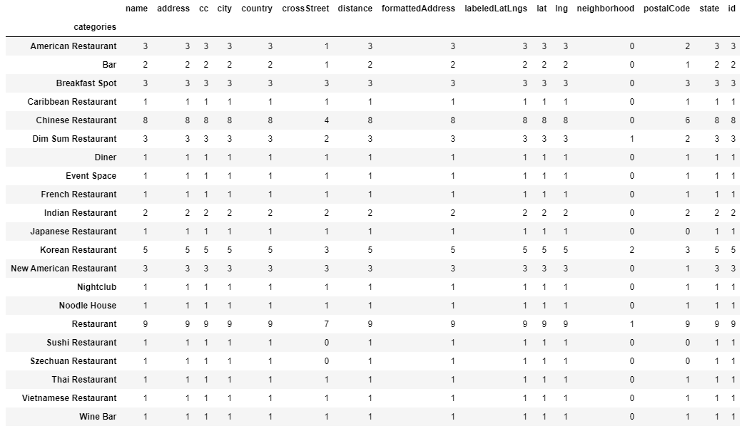
Empirical Results
Toronto Restaurant list:

Slide 14
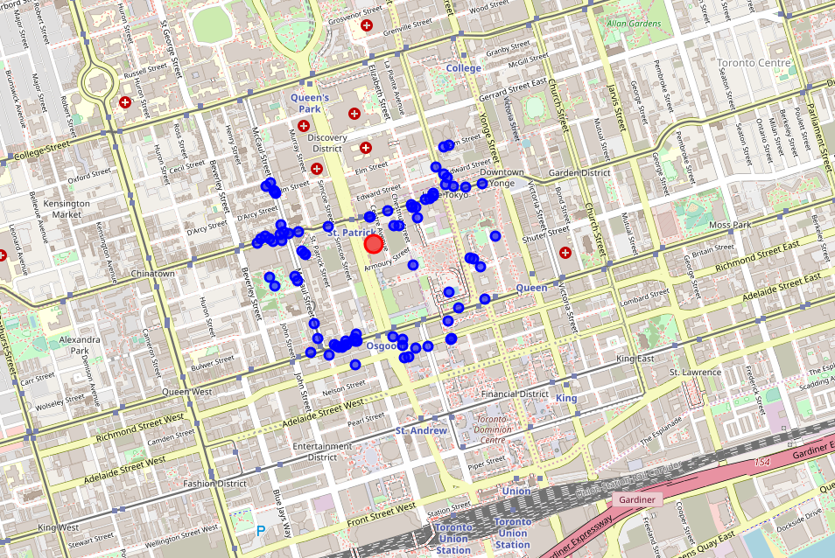
Toronto Interesting Spots

Slide 15
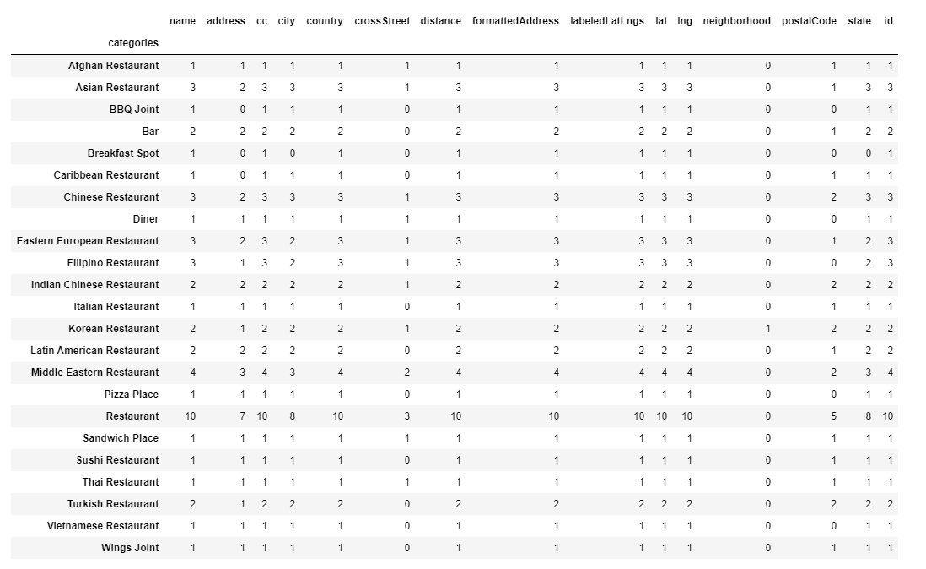
North York Restaurants

Slide 16
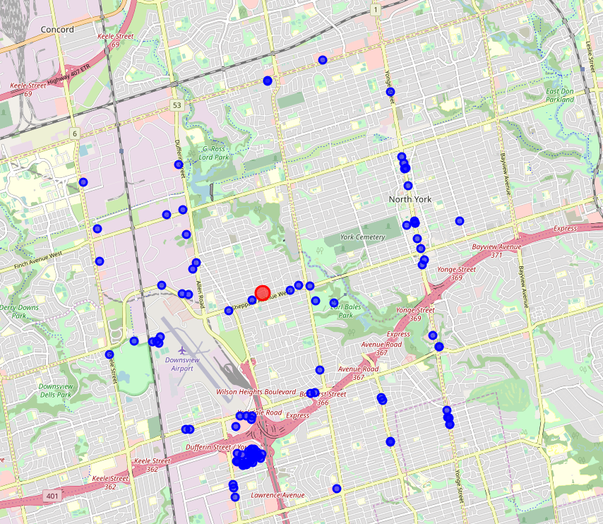
North York Interesting Spots

Slide 17
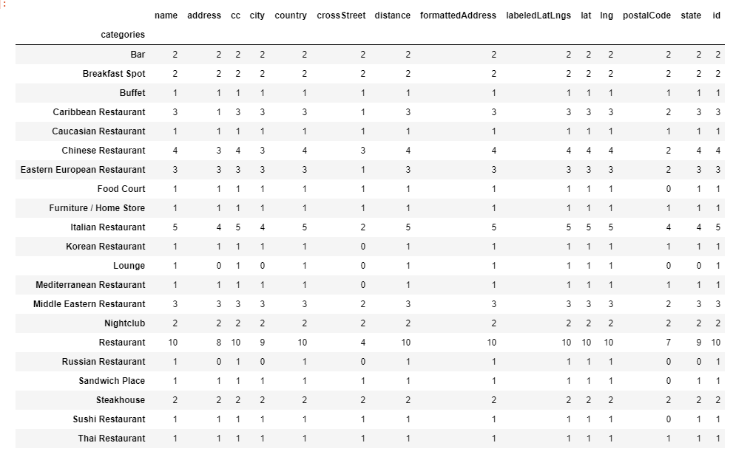
Vaughan Restaurant List

Slide 18
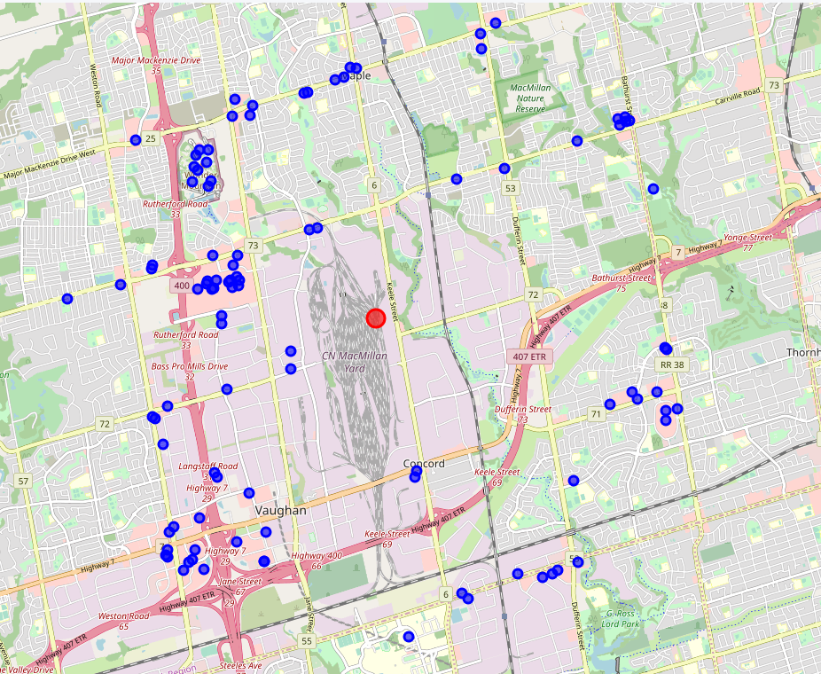
Vaughan Interesting Spots

Slide 19
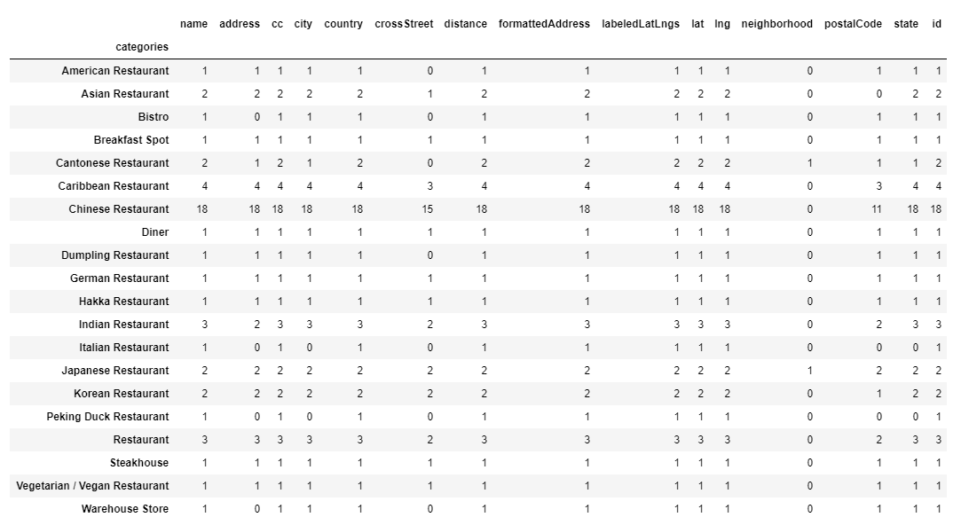
Scarborough Restaurant List

Slide 20
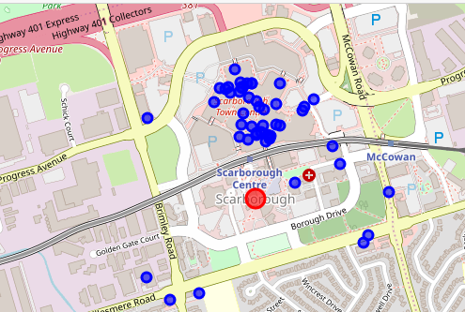
Scarborough Interesting Spots

Slide 21
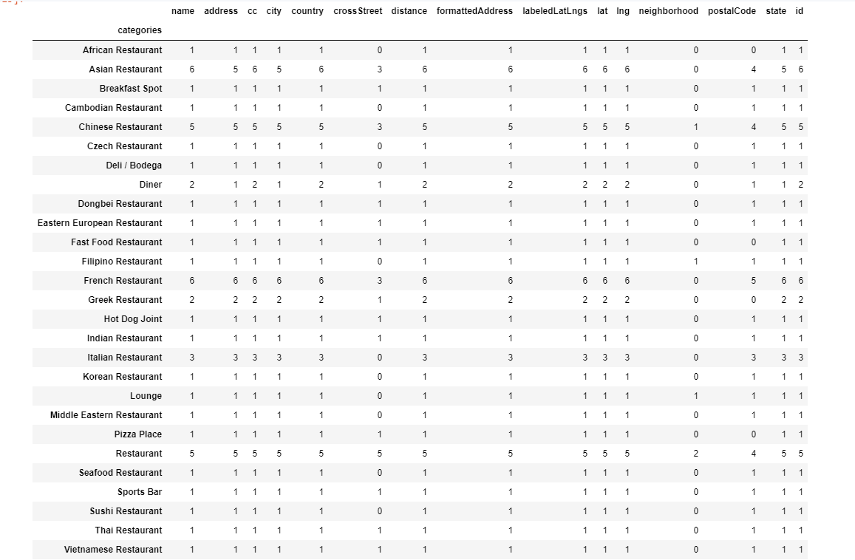
Montreal Restaurant List

Slide 22
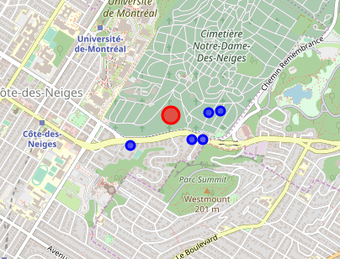
Montreal Interesting Spots

Slide 23
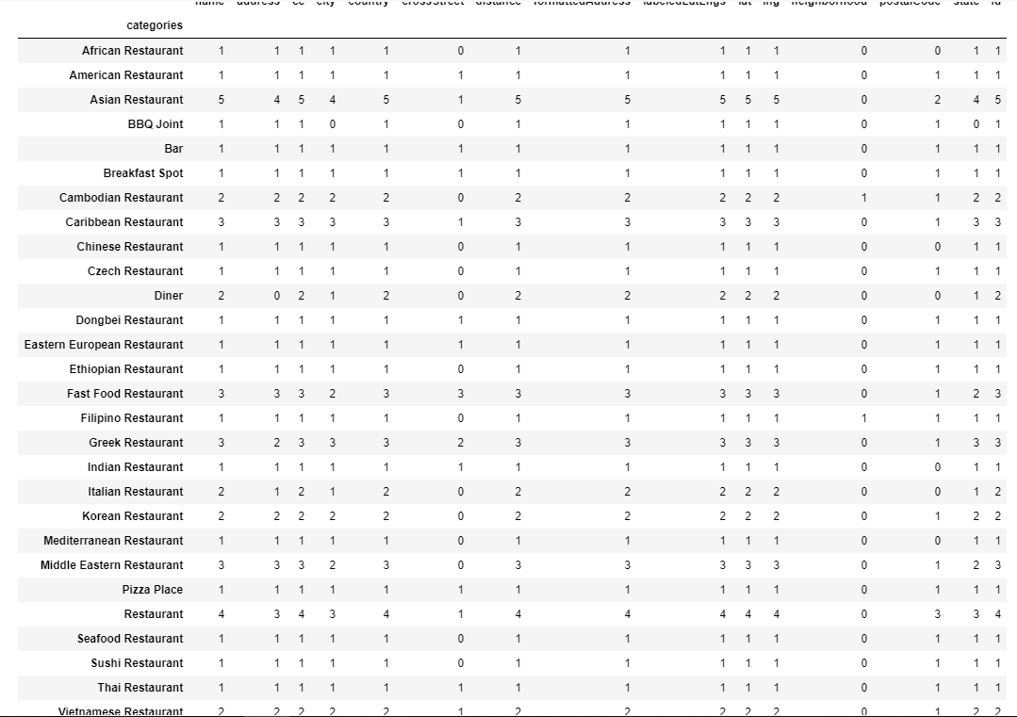
Côte-Saint-Luc Restaurant List

Slide 24
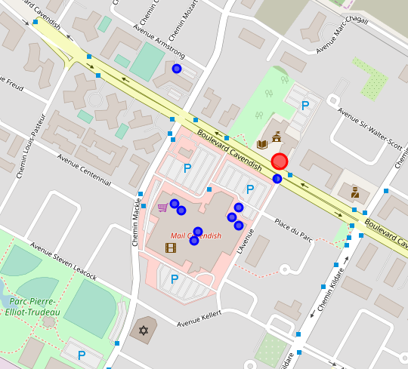
Côte-Saint-Luc Interesting Spots

Slide 25
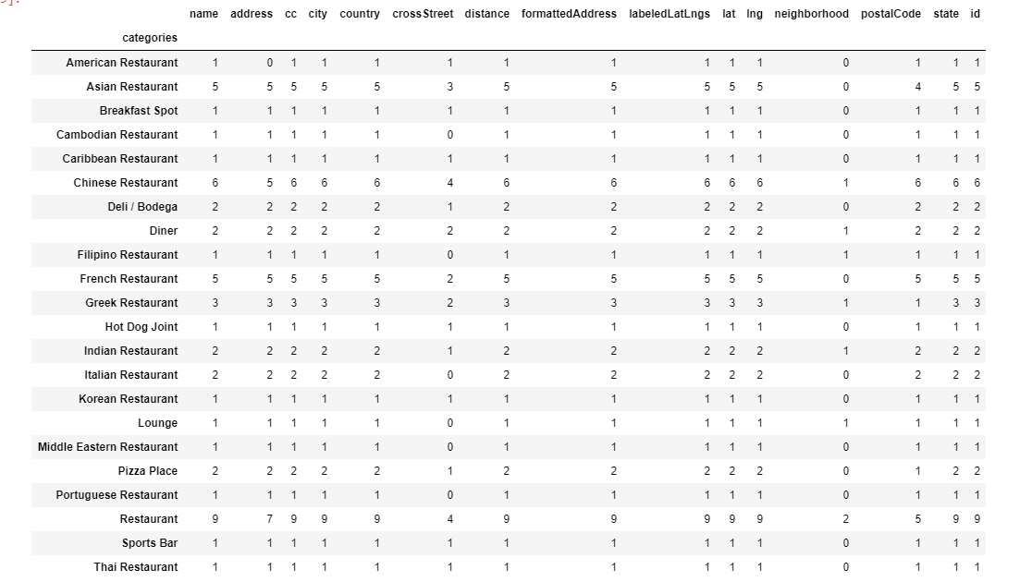
Mount Royal Restaurant List

Slide 26
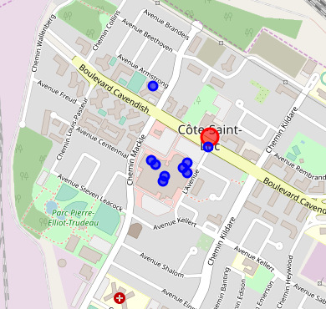
Mount Royal Interesting Spots

Slide 27
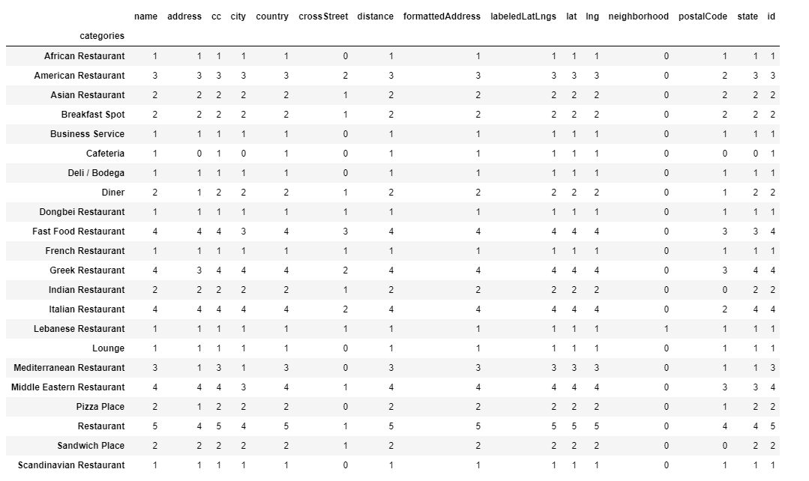
Saint Laurent Restaurant List

Slide 28
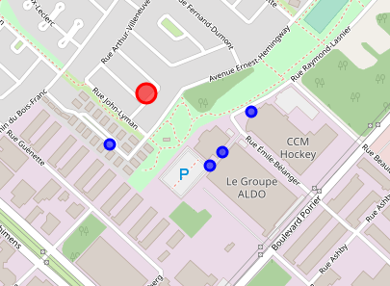
Saint Laurent Interesting Spots

Slide 29
Discussion - 5.1 Big neighborhoods
According to the results, with all the consumptions and limitations we set, Toronto has 12 Chinese restaurants, 6 American restaurants, 5 Korean restaurants, 3 bars, 2 Indian restaurants, 2 Japanese restaurants, 1 Thai restaurant, 1 French restaurant, 1 Vietnamese restaurant, 1 Caribbean restaurant.
Montreal has 6 Chinese restaurants, 6 French restaurants, 3 Italian restaurants, 2 Greek restaurants, 1 Czech restaurant, 1 Cambodian restaurant, 1Eastern European restaurant, 1 African restaurant, 1 Filipino restaurant, 1 Indian restaurant, 1 Japanese restaurant, 1 Thai restaurant, 1 Vietnamese restaurant.
The most observable difference between Toronto and Montreal is Montreal has more European restaurants than Toronto. Specifically, with the radius we investigated, there is only 1 European restaurant in Toronto whereas in Montreal, the number of European restaurants is 12 European restaurants. Not surprisingly, Montreal has more French restaurants than Toronto. Investors with the motivation of opening the European restaurant especially the French restaurant should aware of this result.

Slide 30
5.1 Big neighborhoods – Cont’d
For the investors who want to open an Asian restaurant, especially the Chinese restaurant may face a more competitive market than other cuisine markets. The Asian restaurant market may already fully packed.
What is more, in Toronto, interesting spots around St. Patrick. Thus, investors may consider this area among other places since there is no obvious similar pattern with the map of Toronto restaurants. On the other hand, the interesting spots of Montreal does not have as much information as Toronto’s.

Slide 31
5.2 Small neighborhoods - 5.2.1 Toronto
After discussing the large picture of the two big neighborhoods, we move our step onto the small neighborhoods of each city. In terms of Toronto, we have analyzed 3 neighborhoods, namely, North York, Vaughan, and Scarborough. North York has 4 Middle Eastern restaurants, 3 Chinese restaurants, 3 Asian restaurants, 3 Eastern European restaurants, 3 Filipino restaurants, 2 Bars, 2 Indian Chinese restaurants, 2 Turkish restaurants, 2 Korean restaurants. Vaughan has 5 Italian restaurants, 4 Chinese restaurants, 3 Caribbean restaurants, 3 Eastern European restaurants, 3 Middle Eastern restaurants, 2 Bars, 2 Steakhouse. Scarborough has 20 Chinese restaurants, 4 Caribbean restaurants, 3 Indian restaurants, 2 Japanese restaurants, 2 Korean restaurants, 2 Asian restaurants.

Slide 32
5.2.1 Toronto – Cont’d
In terms of the diversity, North York has more diversified cuisine than the other two neighborhoods whereas Scarborough has the least diversified restaurant type. Asian food has more weight than other cuisine in all three areas. Therefore, investors with the intension to open an Asian restaurant should notice that, especially for those who wants to open a Chinese restaurant at Scarborough. Vaughan has more European restaurants than other two places. Therefore, it has the most balanced diversity than the other two neighborhoods. With the consideration of the population, North York’s population is 672,955, Vaughan’s population is 323,281 and the population of Scarborough 632,098. One may can say that the more balanced diversity of restaurant type in Vaughan is the result of less population. However, a more detailed investigation is needed regarding the race of each neighborhood.

Slide 33
5.2.1 Toronto – Cont’d
With regard to the interesting spots, investors who want to run the business in Vaughan may consider the place along with highway 400. In North York, the intersection of 401 Express and Lawrence Avenue is a good place to start. What is more, Shepperd Avenue and Yonge Street are two most popular places that may have more customer. In the case of Scarborough, the interesting spots clustered around the Scarborough Town Centre. However, the shopping center has food court inside the mall, which may be devalue the information we get from this analysis.

Slide 34
5.2.2 Montreal:
Regarding the city of Montreal, we have analyzed the three neighborhoods that are Côte-Saint-Luc, Mount Royal, and Saint Laurent. Côte-Saint-Luc has 5 Asian restaurants, 3 Caribbean restaurants, 3 Middle Eastern restaurants, 3 Greek restaurants, 3 fast food restaurants, 2 Cambodian restaurants, 2 Korean restaurants, 2 Vietnamese restaurants. Mount Royal has 6 Chinese restaurants, 5 Asian restaurants, 5 French restaurants, 3 Greek restaurants, 2 Indian restaurants, 2 Italian restaurants. Saint Laurent has 4 Italian restaurants, 4 Middle Eastern restaurants, 4 Greek restaurants, 3 American restaurants, 3 Mediterranean restaurants, 2 Asian restaurants, 2 Indian restaurants.

Slide 35
5.2.2 Montreal – Cont’d
Investors should notice that the Mount Royal has the greatest number of Chinese restaurants as well as the Asian restaurants. Saint Laurent has more European restaurants than the other two neighborhoods. Côte-Saint-Luc has the most diverse restaurant type among these three places. In short, we do notice the cultural influence yields a much different restaurant distribution in Montreal than in Toronto. This confirms the result we have discovered in big neighborhoods.

Slide 36
5.2.2 Montreal – Cont’d
The neighborhoods in Montreal have more diverse restaurant type than the neighborhoods in Toronto. However, the population in Montreal is not as comparable as the population in Toronto. The population in Mount Royal is 9,534, the population of Côte-Saint-Luc is 32,321, and the population of Saint Laurent is 98,828. Investors should also be aware of this factor.
The information from the interesting spots of Montreal is not as informative as spots in Toronto. In Saint Laurent, investors can focus on the route of 117 and 15 whereas investors may not have to consider the interesting spots factor when they invest.

Slide 37
Conclusion
In this project, we have investigated the restaurant distribution information for both big and small neighborhoods. We have focused on the two most populated and developed cities in Canada as well as the small neighborhoods inside each city.
The project is designed for providing the useful information to the investors or business runners who is going to open a restaurant in either of these two cities. One may require more detailed information regarding this food industry and may find the results from this project are useful.

Slide 38
Conclusion – Cont’d
From the discussion, we can conclude that Montreal has more diverse restaurant type than Toronto. However, with the consideration of population, we find the pattern that small population may yield a more balanced restaurant type distribution than the neighborhoods that have larger population. The relation between population and restaurant may require further investigation.
Besides, we find the culture plays a vital role is the restaurant business. As a French culture-based city, Montreal has more European restaurants than Toronto. We recommend that the investors who are willing to open a European cuisine restaurant should avoid the clustering of similar food type in Montreal.
Another cultural influence we noticed is that the Asian food has more weight than other cuisine. Specifically, the number of Chinese restaurants surpass the other cuisine in the majority of the neighborhoods we have analyzed, especially at Scarborough.
In terms of the interesting spots, we find the information from the analysis of Toronto is more valuable than the information from Montreal. This may be the result of the huge population gap between these two cities.

Slide 39
Drawbacks
The data we have used in this project only comes from the Foursquare. In order to have a more robust and meaningful result, the further research should consider the other data source.
What is more, this project only considered three small neighborhoods in each city. Further investigation may include more neighborhoods to have a more comprehensive point of view.

Slide 40
Thank you for your time!

